Slide 1
Software Testing
Verification and validation planning
Software inspections
Software Inspection vs. Testing
Automated static analysis
Cleanroom software development
System testing

Slide 2
Verification vs validation
Verification:
"Are we building the product right”.
The software should conform to its specification.
Validation:
"Are we building the right product”.
The software should do what the user really requires.

Slide 3
Static and dynamic verification
Software inspections. Concerned with analysis of
the static system representation to discover problems (static verification)
  May be supplement by tool-based document and code analysis
Software testing. Concerned with exercising and
observing product behaviour (dynamic verification)
  The system is executed with test data and its operational behaviour is observed

Slide 4
Software inspections
Software Inspection involves examining the source representation with the aim of discovering anomalies and defects without execution of a system.
They may be applied to any representation of the system (requirements, design, configuration data, test data, etc.).

Slide 5
Inspections and testing
Inspections and testing are complementary and not opposing verification techniques.
Inspections can check conformance with a specification but not conformance with the customer’s real requirements.
Inspections cannot check non-functional characteristics such as performance, usability, etc.
Management should not use inspections for staff
appraisal i.e. finding out who makes mistakes.

Slide 6
Inspection procedure
System overview presented to inspection team.
Code and associated documents are
distributed to inspection team in advance.
Inspection takes place and discovered errors
are noted.
Modifications are made to repair errors.
Re-inspection may or may not be required.
Checklist of common errors should be used to
drive the inspection. Examples: Initialization, Constant naming, loop termination, array bounds…

Slide 7
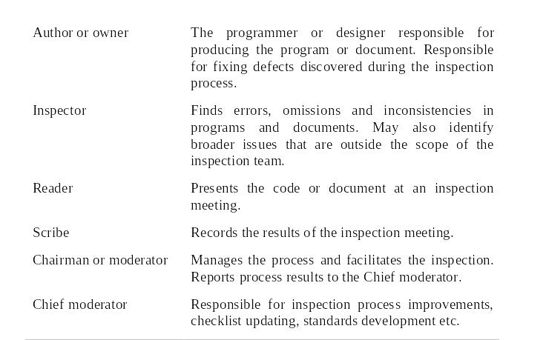
Inspection roles

Slide 8
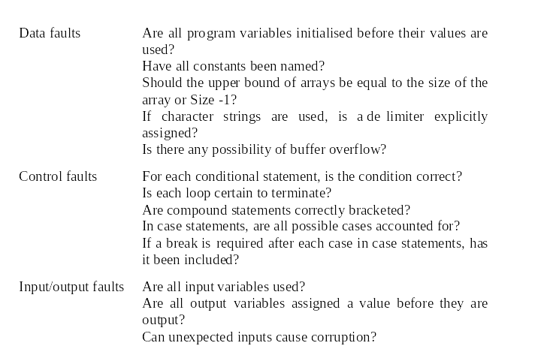
Inspection checks 1

Slide 9
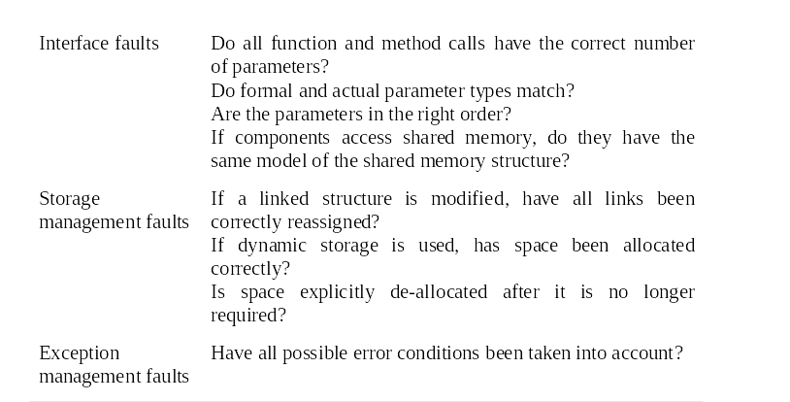
Inspection checks 2

Slide 10
Automated static analysis
Static analysers are software tools for source text processing.
They parse the program text and try to discover potentially erroneous conditions and bring these to the attention of the V & V team.
They are very effective as an aid to inspections - they are a supplement to but not a replacement for inspections.

Slide 11
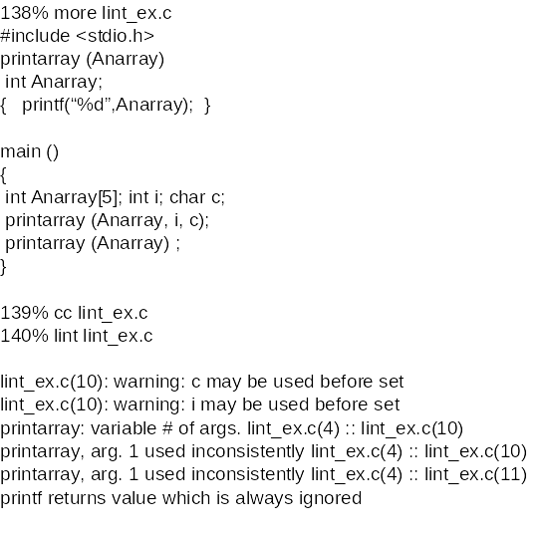
LINT static analysis

Slide 12
Cleanroom software development
The name is derived from the 'Cleanroom'
process in semiconductor fabrication. The
philosophy is defect avoidance rather than
defect removal.
This software development process is based on:
  Incremental development;
  Formal specification;
  Static verification using correctness arguments;
  Statistical testing to determine program reliability.

Slide 13
Cleanroom process teams
Specification team. Responsible for developing
and maintaining the system specification.
Development team. Responsible for
developing and verifying the software. The
software is NOT executed or even compiled
during this process.
Certification team. Responsible for developing
a set of statistical tests to exercise the software
after development. Reliability growth models
used to determine when reliability is acceptable.

Slide 14
System testing
Involves integrating components to create a system or sub-system.
May involve testing an increment to be delivered to the customer.
Two phases:
  Integration testing - the test team have access to the system source code. The system is tested as components are integrated.
  Release testing - the test team test the complete system to be delivered as a black-box.

Slide 15
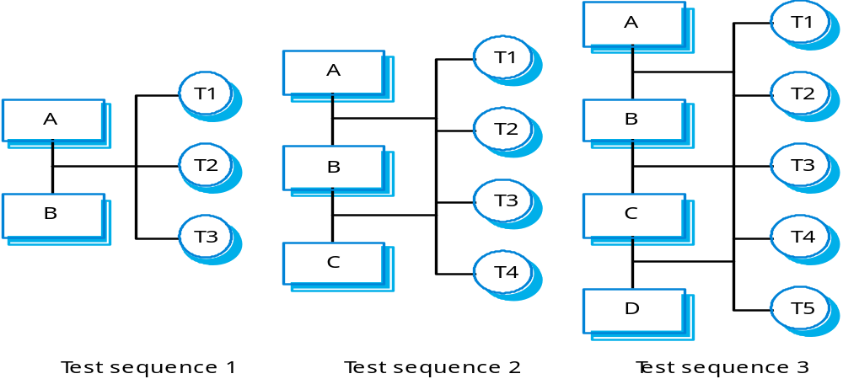
Incremental integration testing

Slide 16
Release testing
The process of testing a release of a system that will be distributed to customers.
Primary goal is to increase the supplier’s confidence that the system meets its requirements.
Release testing is usually black-box or functional testing
  Based on the system specification only;
  Testers do not have knowledge of the system implementation.

Slide 17
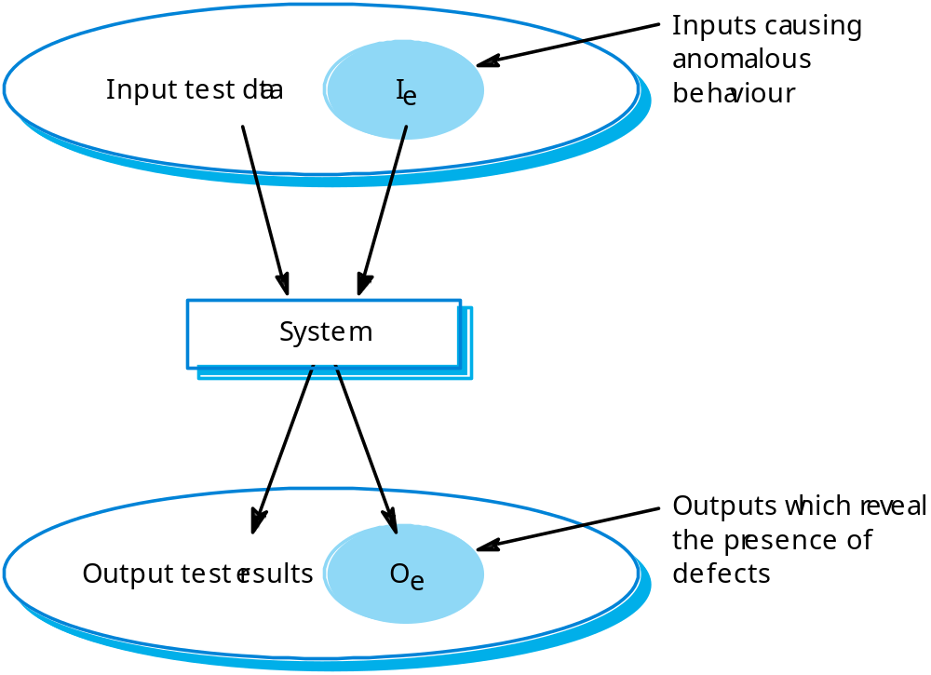
Black-box testing

Slide 18
Stress testing
Exercises the system beyond its maximum design load. Stressing the system often causes defects to
come to light.
Stressing the system test failure behaviour.. Systems should not fail catastrophically. Stress testing checks for unacceptable loss of service or data.
Stress testing is particularly relevant to distributed systems that can exhibit severe degradation as a
network becomes overloaded.

Slide 19
Component testing
Component or unit testing is the process of testing individual components in isolation.
It is a defect testing process.
Components may be:
  Individual functions or methods within an object;
  Object classes with several attributes and methods;
  Composite components with defined interfaces used to access their functionality.

Slide 20
Object class testing
Complete test coverage of a class involves
  Testing all operations associated with an object;
  Setting and interrogating all object attributes;
  Exercising the object in all possible states.
Inheritance makes it more difficult to design object class tests as the information to be tested is not localised.

Slide 21
Interface testing
Objectives are to detect faults due to interface errors or invalid assumptions about interfaces.
Particularly important for object-oriented development as objects are defined by their interfaces.

Slide 22
Interface types
Parameter interfaces
  Data passed from one procedure to another.
Shared memory interfaces
  Block of memory is shared between procedures or functions.
Procedural interfaces
  Sub-system encapsulates a set of procedures to be called by other sub-systems.
Message passing interfaces
  Sub-systems request services from other sub-system.s

Slide 23
Test case design
Involves designing the test cases (inputs and outputs) used to test the system.
The goal of test case design is to create a set of tests that are effective in validation and defect testing.
Design approaches:
  Requirements-based testing (i.e. trace test cases to the requirements)
  Partition testing;
  Structural testing.

Slide 24
Partition testing
Input data and output results often fall into different classes where all members of a class are related.
Each of these classes is an equivalence partition or domain where the program behaves in an equivalent way for each class member.
Test cases should be chosen from each partition.

Slide 25
Structural testing
Sometime called white-box testing.
Derivation of test cases according to program structure. Knowledge of the program is used to identify additional test cases.
Objective is to exercise all program statements (not all path combinations).

Slide 26
Path testing
The objective of path testing is to ensure that the set of test cases is such that each path through the program is executed at least once.
The starting point for path testing is a program flow graph that shows nodes representing program decisions and arcs representing the flow of control.
Statements with conditions are therefore nodes in the flow graph.

Slide 27
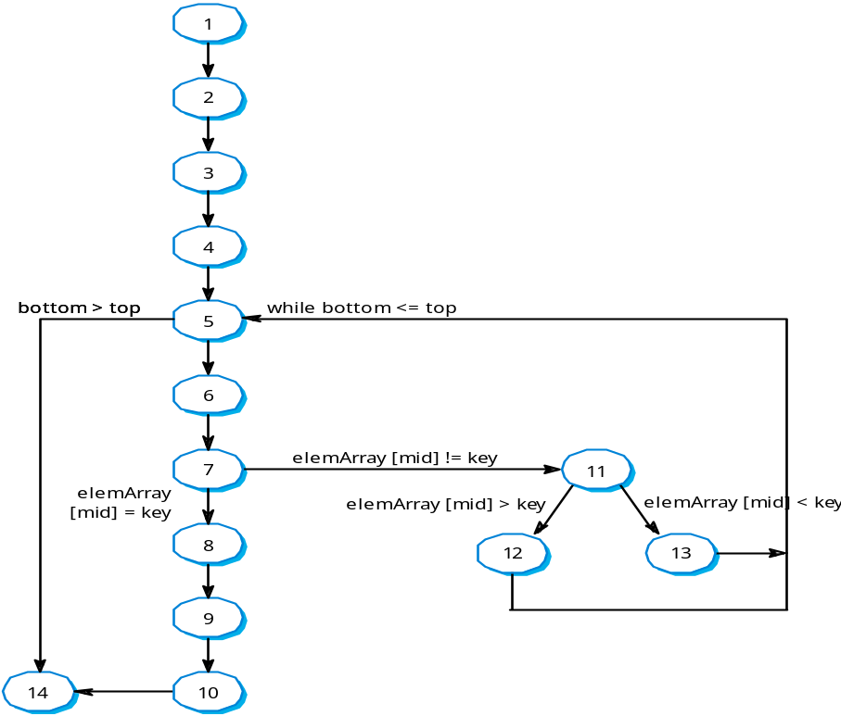
Binary search flow graph

Slide 28
Independent paths
1, 2, 3, 4, 5, 6, 7, 8, 9, 10, 14
1, 2, 3, 4, 5, 14
1, 2, 3, 4, 5, 6, 7, 11, 12, 5, …
1, 2, 3, 4, 6, 7, 2, 11, 13, 5, …
Test cases should be derived so that all of these paths are executed
A dynamic program analyser may be used to check that paths have been executed

Slide 29
Test automation
Testing is an expensive process phase. Testing workbenches provide a range of tools to reduce the time required and total testing costs.
Systems such as Junit support the automatic execution of tests.
Most testing workbenches are open systems because testing needs are organisation-specific.
They are sometimes difficult to integrate with closed design and analysis workbenches.

